Slide 1
Executive Summaries

Slide 2
Executive Summary: Assessment JLL
7920 Active users
8108 Registered Users
15989 Projects
90984 Suppliers
46283 Active Suppliers
What’s Working:
Consistent use of Contracts and Sourcing+ modules
Good job awarding in the system
Good use of sourcing envelopes
Recommendations:
RFx:
Consider using Program Manager to create projects
Majority of users are creating RFX’s from another RFX. Consider leveraging the RFX templates that have been created to decrease time in creating sourcing events
Low usage of Auctions Module. Using Auctions can help increase competition between suppliers and allow for greater savings.
Consider using the RFX creation wizard to assist in creating rfx’s in the system
Turn on Value Tracker for additional savings
Contracts:
Increase usage of digital signature
Review templates and consider creating additional templates so that users can avoid creating contracts from scratch
Consider using Contracts+ to take advantage of new features and functionality
Opportunities:
Contracts+
Adopt to increase adoption and assist with training new users

Slide 3
Executive summary: Supply Ontario Assessment Report
What’s Working:
Consistent use of the Sourcing module
Good job awarding in the system
Good use of sourcing envelopes
469 Active users
1658 Registered Users
6024 Projects
7603 RFX’s
55705 Suppliers
53485 Active Suppliers
Recommendations:
RFx:
Start using the auctions module. Using auctions can help increase competition between suppliers and allow for greater savings.
Some events are still being created from scratch. Consider reviewing templates to see if new ones need to be added and/or existing ones should be updated
Use the RFX wizard to save time creating sourcing events
Increase usage of the contract module
General:
Enable standard adopt guides for quick wins
Opportunities:
Contracts+ and Supplier Management+ full suite
Adopt to increase adoption and assist with training new users

Slide 4
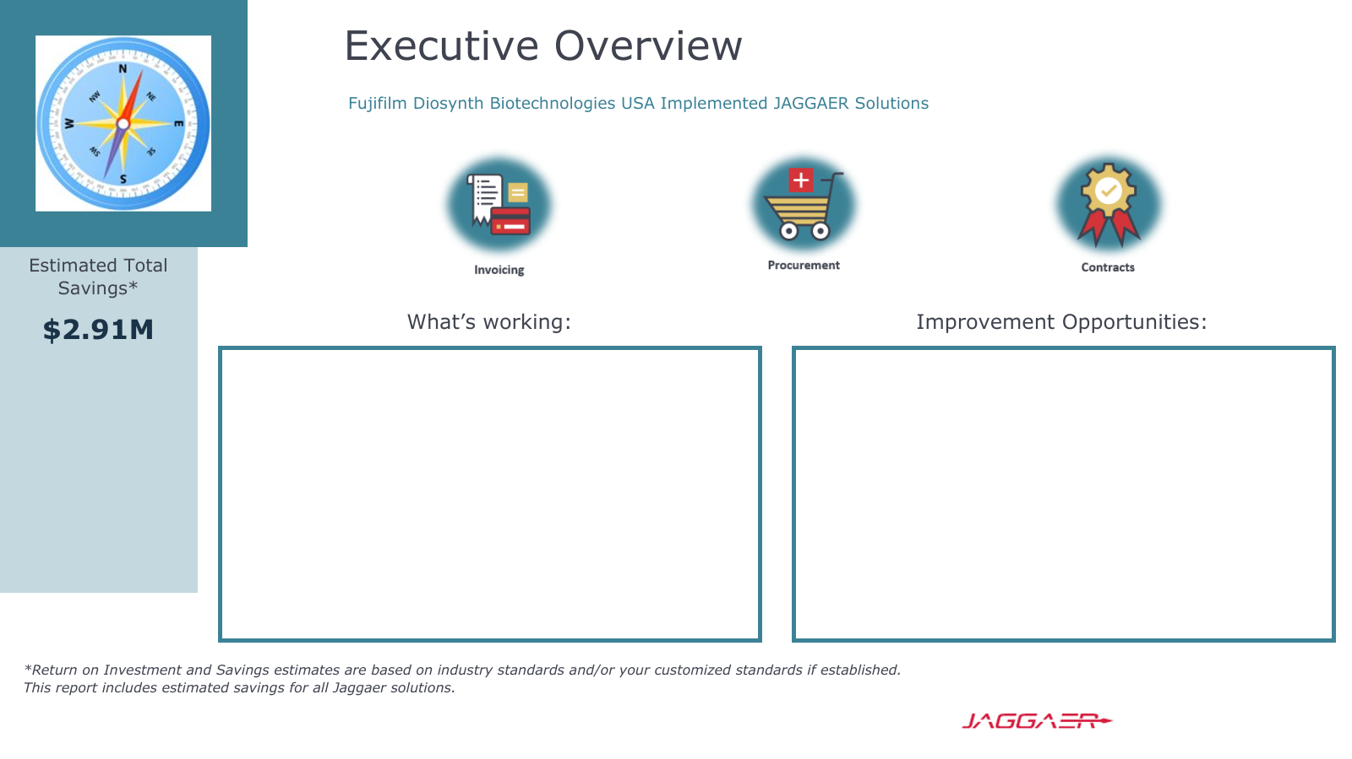
Spend under management is best in class
Good job in ensuring automated capture of invoices
Number of contracts is best in class at 4397 contracts compared to the industry average of 2.9K
Increase number of semi-automated invoices to capture savings and reduce overhead
Consider using CCT and creating contract amendments
Invoice cycle time can be increased by configuring email approvals and using the mobile app
Contract cycle times can be reduced as well by using mobile app

Slide 5
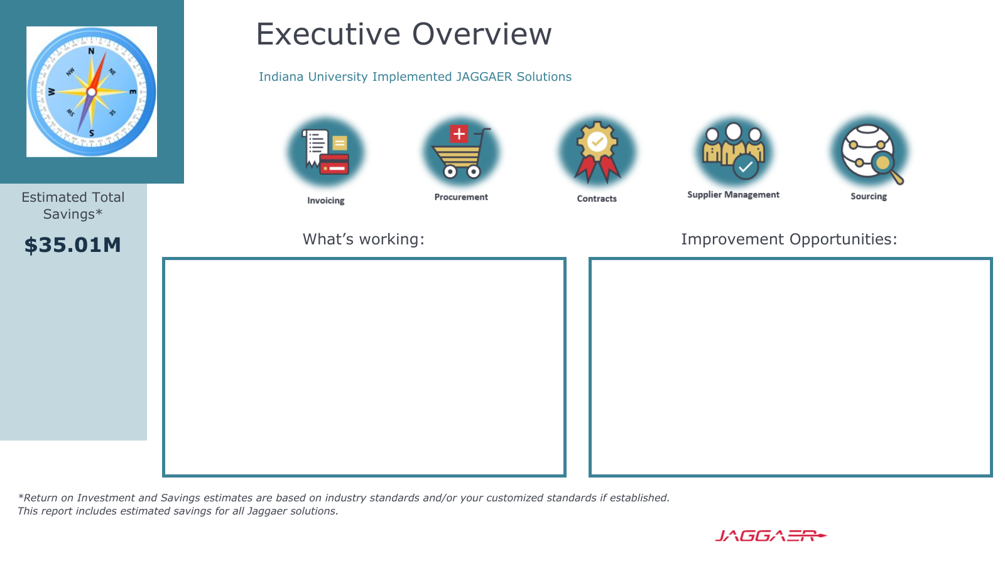
Adoption score is best in class
High spend under management
Invoice cycle time in days is 1.4 which is excellent
83% automated capture
Contract average cycle time in days is best in class at 4.4 days
Consider using historical prices in sourcing events
Review internal processes and encourage the creation of contract renewals
Enable adopt/assist to decrease time spent training new hires and increase usage
Consider using Contracts AI

